Slide 1



Indian Banking Transactions
Indian banking transactions are integral to the nation's economy, facilitating financial operations across various sectors. This presentation explores the types, processes, and significance of these transactions in India's banking system.
Presented by : Mohammed Mahaboob Subhani

Slide 2


Back Story on Indian Banking Transactions.
Data Understanding.
Business Objective and Problem Statement.
Color Palette.
Data Cleaning , Data Transformation and Visualization.
Fraud Insights and Sales Revenue Visualization
Types of Banking Transaction.
Digital Banking Transaction.
Regulatory Framework.
Challenges in Transaction.
Conclusion.
Index

Slide 3
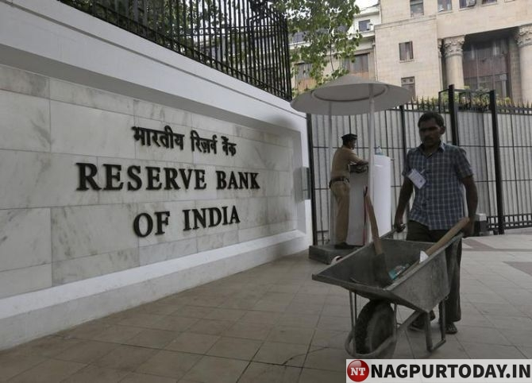
Early Days of Indian Banking
The history of Indian banking dates back to the 18th century, with the establishment of the General Bank of India in 1786. However, it was the State Bank of India (SBI), founded in 1806 as the Bank of Calcutta, that played a pivotal role in shaping the country's banking landscape.
Nationalization and Expansion
In 1969, the Indian government nationalized 14 major banks, including SBI, to increase financial inclusion and provide banking services to rural areas. This move led to a significant expansion of banking services across the country.
Digitalization and Innovation
In recent years, Indian banking has undergone a significant transformation with the adoption of digital technologies. The launch of the Unified Payments Interface (UPI) in 2016 revolutionized digital payments, enabling users to transfer funds instantly between banks.
Paytm's UPI Success Story
Paytm, a leading digital payments platform in India, has been at the forefront of UPI adoption. With over 300 million registered users, Paytm's UPI platform has processed billions of transactions, making it one of the most popular digital payment platforms in the country.
Back Story on Indian Banking Transaction

Slide 4
Customer Name – Account holder’s name
Account Number – Unique bank account number
Transaction Date – Date of the transaction
Transaction Type – Deposit, Withdrawal, Transfer
Amount – Transaction amount
Channel – UPI, ATM, Online Banking, Branch, Mobile App
Region – North, South, East, West, Central, North-East
Branch Name – Actual Indian city branch (e.g., Delhi CP, Mumbai Andheri)
Account Type – Savings, Current, FD, RD, etc.
Is Fraud – Yes/No flag indicating suspected Fraud
Data Understanding

Slide 5

Business Objectives
Problem Statement
Analyze transaction trends across branches and regions.
Identify fraud-prone accounts and patterns.
Evaluate the performance of digital vs. branch-based channels.
Track the status of transactions (Completed, Failed, Reversed).
Build a comprehensive Excel dashboard to visualize key banking KPIs for leadership teams
What are the regional and monthly transaction trends?
Which branches handle the highest and lowest transaction volumes?
What is the breakdown of deposits, withdrawals, and transfers?
Are there any signs of fraudulent transactions?
How does each channel (UPI, ATM, Online, etc.) perform?
What proportion of transactions are failed or reversed?

Slide 6

Color Palette Indication
Red
Indicates Credit Card Payments , Central Region and Status Wise Transaction (Digital)
Orange
None
Yellow
Indicates South Region
Green
Indicates Debit Card Payments and North Region
Blue
Indicated UPI Payments and East Region
Indigo
Indicates Cash Payments and Status Wise Transaction(Branch Based)
Violet
Indicates Net Banking And West Region

Slide 7

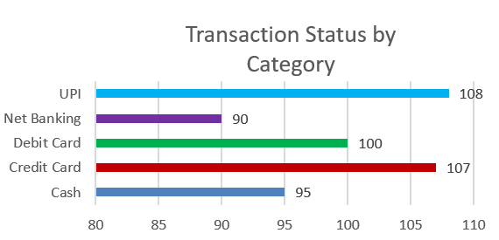
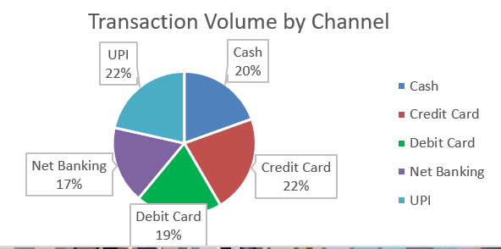
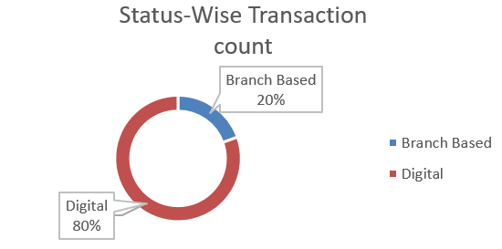
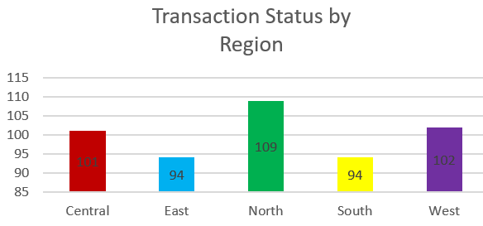
Visualization by Channel
Removed all blanks and Duplicate Values from the data set
Derive Year-Month from Transaction Date
Create Net Change from previous balance to current
Calculate Fraud Rate % by region or branch
Create Transaction Category Column by Payment Mode
Data Cleaning & Data Transformation

Slide 8
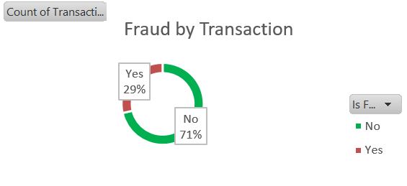
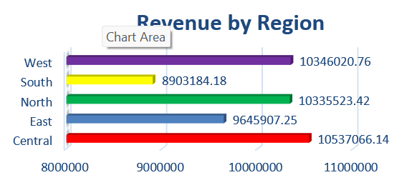
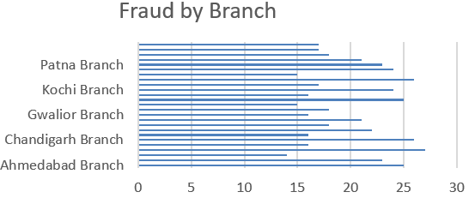
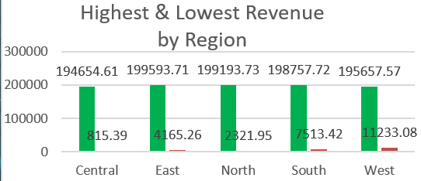
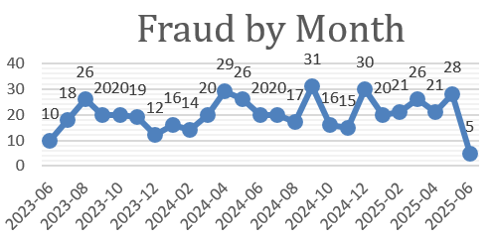
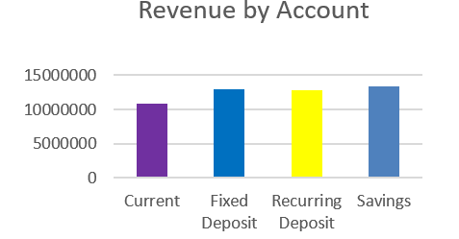
Fraud Insights
Sales Revenue Analysis

Slide 9

Types of Banking Transactions
Deposit Transactions
Withdrawal Transactions
Account holders can withdraw funds from their accounts through ATMs or bank branches. This process involves verification to ensure security and prevent fraud.
Customers deposit money into their bank accounts, which can be savings, current, or fixed deposits. These transactions are crucial for banks to maintain liquidity and offer loans.
Transfer Transactions
Loan Transactions
Fund transfers between accounts can occur within the same bank or across different banks, often facilitated by NEFT, RTGS, or IMPS systems, ensuring quick and efficient payment processing.
Banks provide loans for personal, home, and business needs. The transaction involves application, approval, and disbursement, along with interest rate agreements and repayment terms.

Slide 10




Digital Banking Transformation
Online Banking Services
Mobile Banking Applications
The rise of internet banking allows customers to perform transactions from anywhere, enhancing convenience and reducing the need for physical branch visits.
With the proliferation of smartphones, mobile banking apps provide users with easy access to their accounts, enabling transactions like bill payments and money transfers on the go.
1
2
Cybersecurity Measures
4
3
Digital Payment Systems
As digital transactions increase, banks invest heavily in cybersecurity to protect customer data and prevent fraud, employing encryption and multi-factor authentication.
Platforms like UPI, Paytm, and PhonePe have revolutionized payment methods, allowing seamless peer-to-peer transactions and merchant payments with minimal transaction fees.

Slide 11
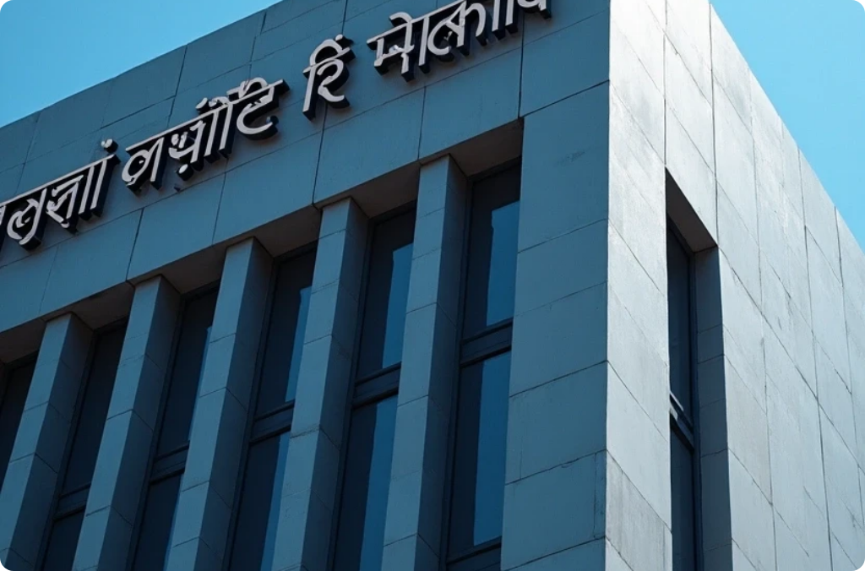


Regulatory Framework
Reserve Bank of India (RBI)
Banking Regulation Act
Customer Protection Regulations
The RBI regulates banking transactions in India, ensuring stability and trust in the financial system.
This act governs the operations of banks, stipulating requirements for transaction reporting and compliance.
Laws are in place to protect customers, ensuring transparency and recourse in case of disputes.

Slide 12

Challenges in Banking Transactions
Fraud and Cybercrime
Technological Barriers
Regulatory Compliance
Increasing digital transactions have led to a rise in cyber fraud, requiring constant vigilance and robust security measures to safeguard customer funds.
Limited access to technology in rural areas can hinder effective banking transactions, necessitating initiatives to improve digital literacy and infrastructure.
Banks face challenges in adhering to various regulations, which can complicate transaction processes and increase operational costs.

Slide 13



Future Trends in Banking Transactions
Blockchain Technology
The adoption of blockchain for transactions promises enhanced security, transparency, and efficiency, particularly in cross-border payments.
2
Artificial Intelligence (AI)
AI is set to revolutionize transaction processing, improving fraud detection and customer service through chatbots and personalized banking experiences.
1
Financial Inclusion Initiatives
3
Efforts to include underbanked populations in the banking system will drive innovation in transaction methods, focusing on accessibility and affordability.

Slide 14

Future of Banking in India
Indian banking transactions are evolving rapidly due to technological advancements and regulatory changes. Embracing digital solutions while addressing challenges will be crucial for the future of banking in India, ensuring financial stability and inclusion for all citizens.
Technological Advancements
Regulatory Changes
Embracing Digital Solutions

Slide 15

Conclusion
Indian banking transactions have undergone a significant transformation, evolving from traditional manual methods to digital platforms. The adoption of technologies like UPI, mobile banking, and online transactions has increased convenience, efficiency, and financial inclusion. This shift has revolutionized the banking landscape, enabling faster, secure, and accessible transactions. Indian banking continues to innovate, embracing emerging technologies to enhance customer experience and drive growth
Thank You !

